Slide 1


Missing
Await
foo
( Promises, concurrency, synchronization,
and a classic bug )
async
bar
baz
KWJS talk

Slide 2
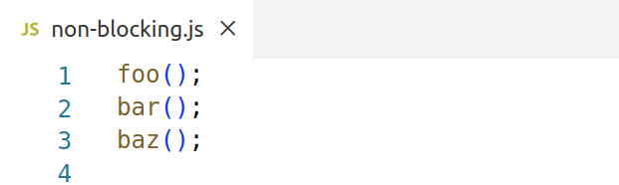
JavaScript is a single non-blocking execution thread
foo
bar
baz

Slide 3
JavaScript is a single non-blocking execution thread
foo
bar
baz
Kinda restrictive, cause only simple execution flow is possible

Slide 4
JavaScript is a single non-blocking execution thread
foo
bar
baz
Can’t wait sanely for external components (server, disk, etc.)
Can only do tricks with callbacks

Slide 5
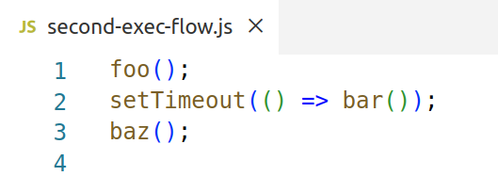
JavaScript execution starts from events like clicks, ticks. Hence, setTimeout() trick
foo
bar
baz

Slide 6
JavaScript execution starts from events like clicks, ticks. Hence, setTimeout() trick
foo
bar
baz
But, we can’t join these flows ... sanely

Slide 7
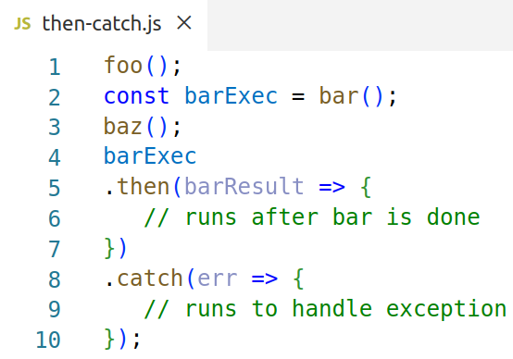
Second order object with execution tail:
Promise with then() and catch()
foo
bar
baz
return
exception

Slide 8
Second order object with execution tail:
Promise with then() and catch()
foo
bar
baz
return
exception
Execution events? Hence, callbacks, callbacks

Slide 9
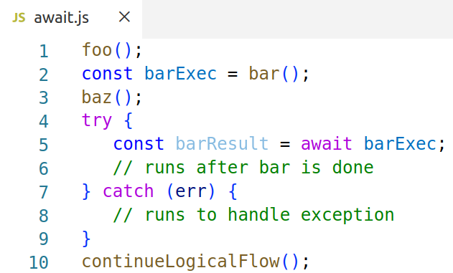
Tie execution tail into logical thread: await logically, don’t block vm thread
foo
bar
baz
await

Slide 10
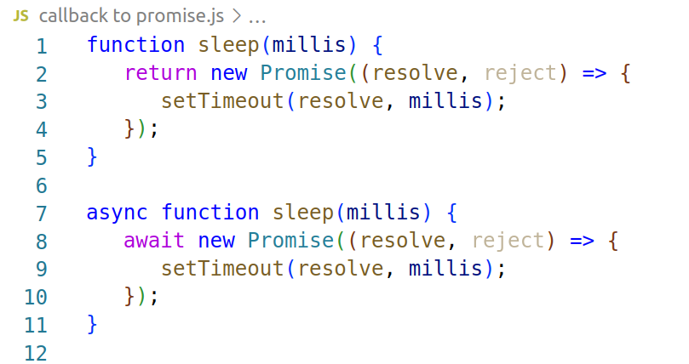
Found useful: turning callbacks’ process flow into more explicit promise flow

Slide 11
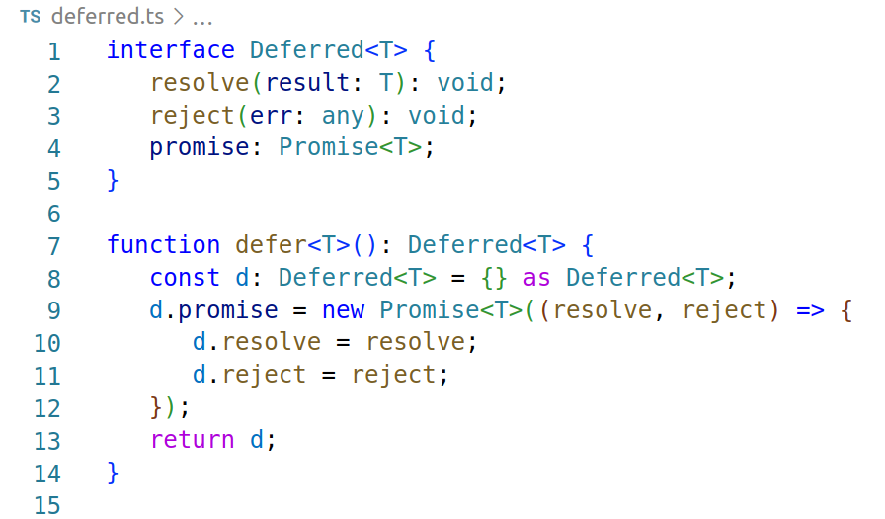
Found useful: sometimes you need deferred

Slide 12
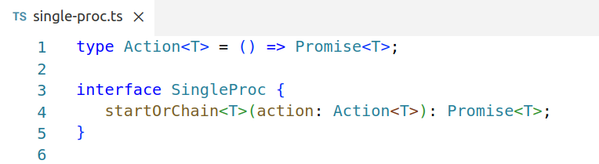
Found useful: synchronization of actions by ordering on a single process chain

Slide 13
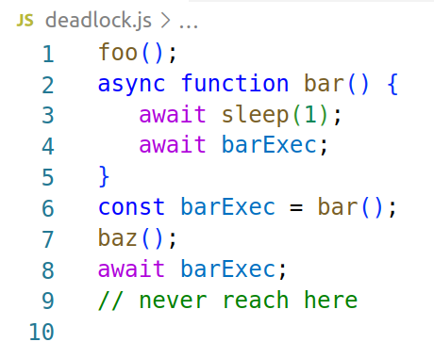
Can even deadlock a non-blocking JS
( tying knots with logical ordering )
foo
bar
baz
Never?

Slide 14
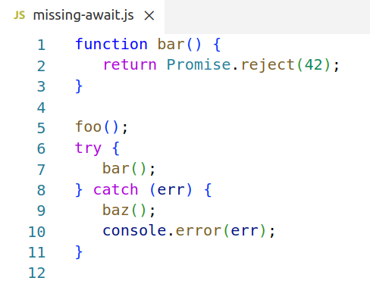

Classical bug: missing await
foo
async
bar
baz

Slide 15

Romeo didn’t wait. So common!

Slide 16
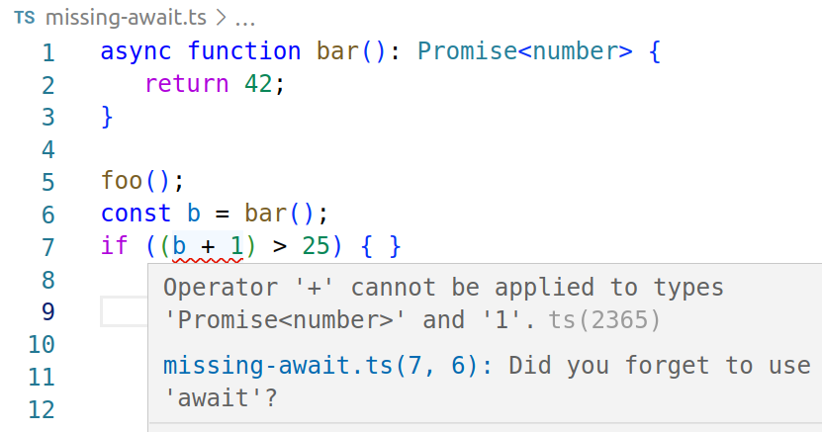
Typescript to rescue

Slide 17
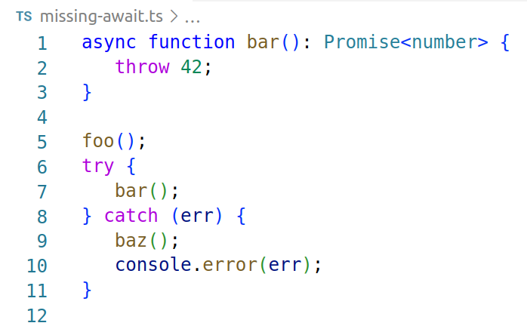
Without assignment to variable use eslint
@typescript-eslint/no-floating-promises rule

Slide 18
In Summary
You can have any logical processes performed by single event loop.
Await/async is a sane way to structure logical processes.
Synchronization ~ Ordering of execution
When computer checks types it helps to catch bugs

Slide 19
On to the demo: https://github.com/3n-mb/missing-await-talk-demo

